Slide 1

PENDRAGON SUPERFOODS EUROPE
International Buisness (DSBW 4)
Matthias Ewald
Adrian Harms

Slide 2
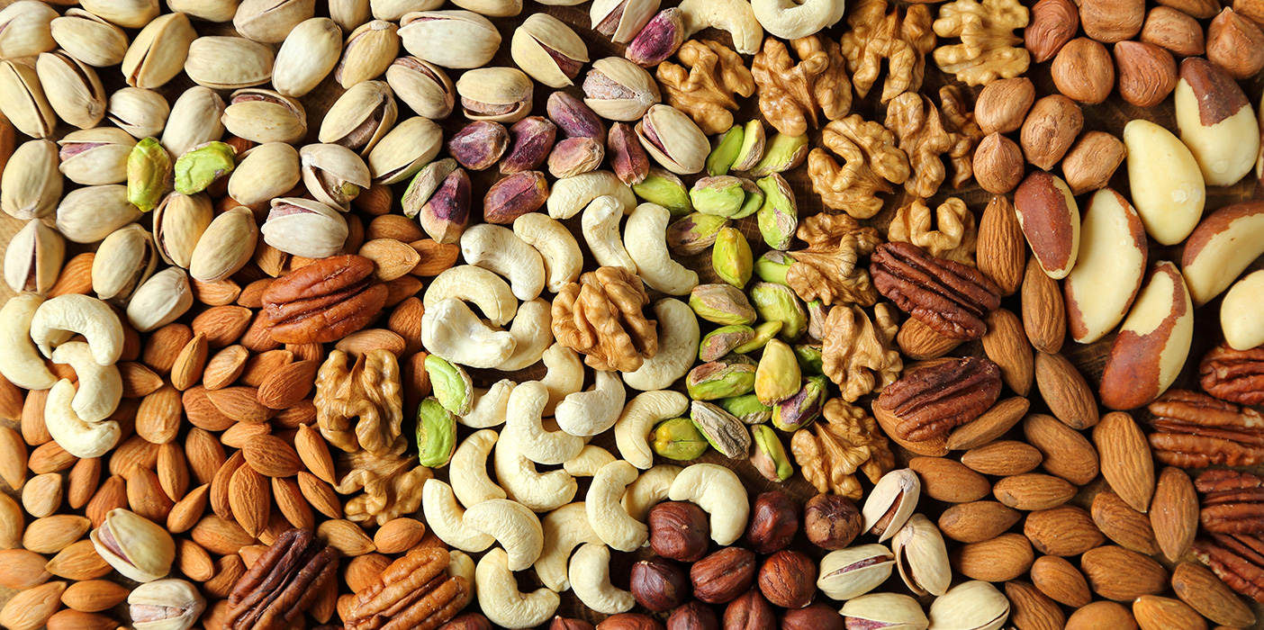
Agenda
Pendragon Snacks
PESTEL Analysis
Market Entry Strategy
Conclusion

Slide 3
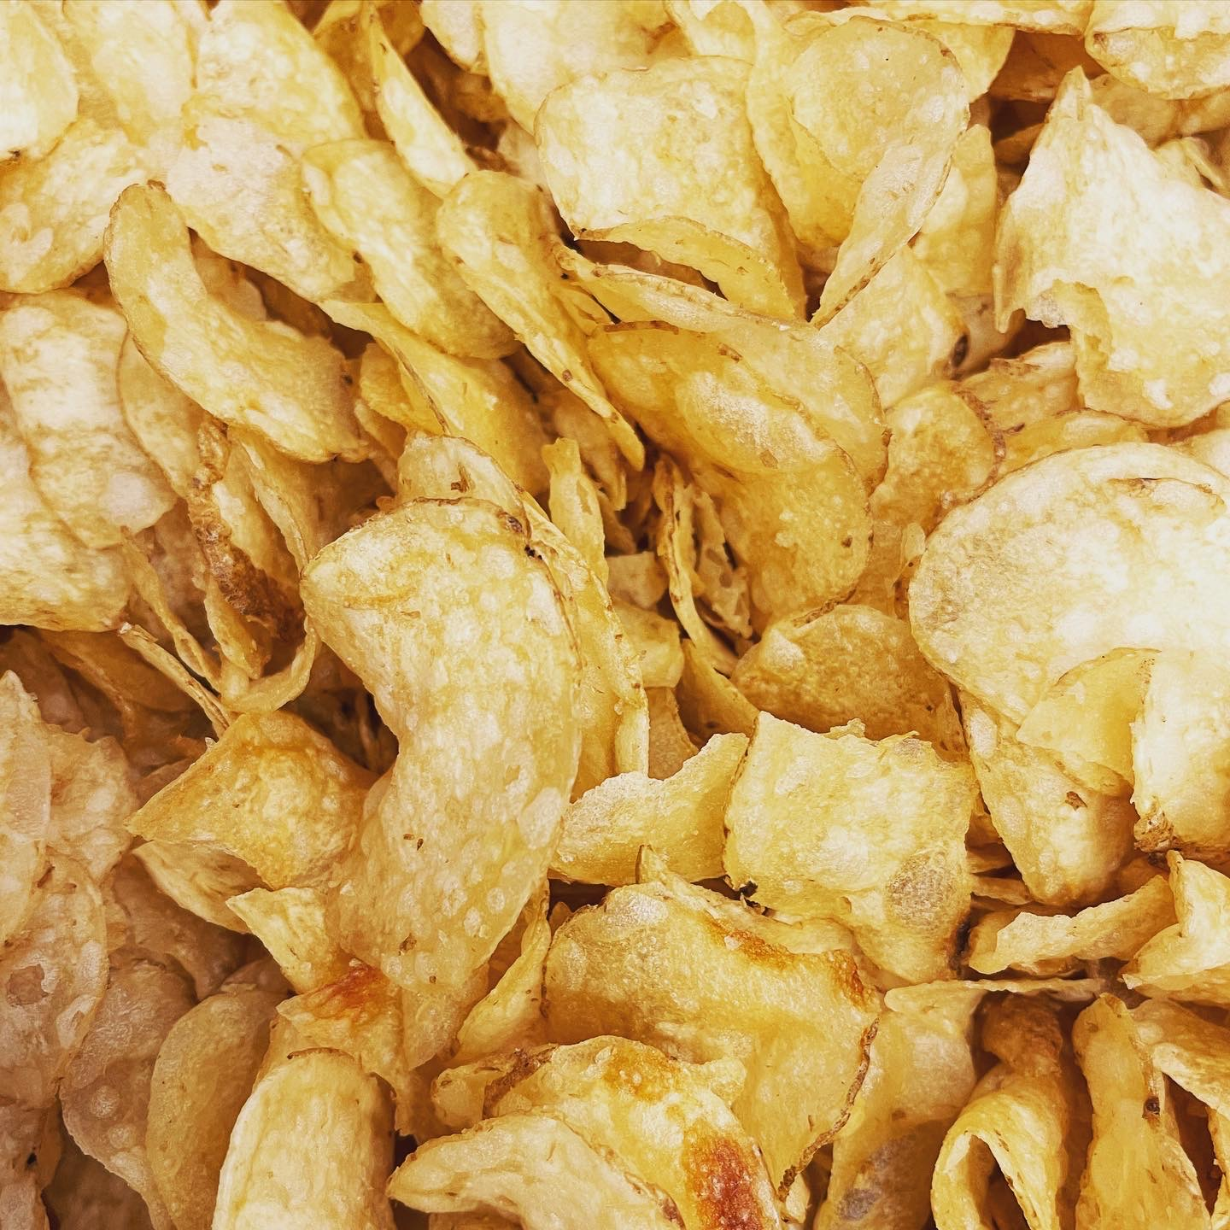
Pendragon Snacks
New Zealand based producer and marketer of healthy snack food
product line consists of low fat, low sodium crisps and flavoured nuts
healthy snacks that are still packed with flavour
target customers are health conscious, middle to upper-class consumers
premium price of NZD 4.99 per 175g pack for crisps and NZD 4.49 for a 130g pack of flavoured nuts

Slide 4
PESTEL Analysis
FOR PENDRAGON SUPERFOODS
IN EUROPE

Slide 5

Political
Trade policies and agreements: Evaluate any potential trade barriers, tariffs, or restrictions that may impact importing and exporting between countries within Europe.
Taxation policies: Consider the impact of tax rates on food products in different European countries, as they can affect pricing and profitability.

Slide 6

Economic
Consumer purchasing power: Pendragon Snacks targets middle to upper-class consumers, so economic factors such as disposable income and spending habits will influence the demand for their premium-priced products.
Economic stability: Assess the economic stability of target countries in Europe to determine the feasibility of market entry and potential market growth.

Slide 7

Social
Health consciousness: Understand the prevalence and importance of health-conscious lifestyles among the middle to upper-class demographic in Europe.
Cultural preferences: Recognize cultural nuances and preferences related to snacking habits, flavours, and ingredient choices in different European countries.

Slide 8
Social Channels
14.06.2023

Slide 9

Technological
Digital adoption: Leverage the high digital adoption rates in Europe to implement effective digital marketing strategies, e-commerce platforms, and online distribution channels.
Product innovation: Stay at the forefront of technological advancements in food processing, packaging, and distribution to continually improve product quality, freshness, and convenience.

Slide 10

Environmental
Sustainable sourcing: Pendragon Snacks should consider environmentally friendly sourcing practices for their ingredients to align with growing consumer preferences for sustainable and ethical products.
Packaging and waste management: Adopting eco-friendly packaging materials and promoting recycling or reusing initiatives can enhance Pendragon Snacks' environmental credentials.

Slide 11

Legal
Food regulations and standards: Comply with European Union regulations regarding food safety, labelling, and packaging, as well as any specific regulations in individual European countries.
Intellectual property protection: Safeguard Pendragon Snacks' unique processes, recipes, and branding through appropriate trademark and patent protections.

Slide 12
Legal Information
 | Kategorie 1 | Kategorie 2 | Kategorie 3 | Kategorie 4
Element 1 | 4.5 | 2.3 | 1.7 | 5
Element 2 | 3.2 | 5.1 | 4.4 | 3
Element 3 | 2.1 | 1.7 | 2.5 | 2.8
Element 4 | 4.5 | 2.2 | 1.7 | 7
14.06.2023

Slide 13
SWOT ANALYSIS
FOR PENDRAGON SUPERFOODS
IN EUROPE

Slide 14

Strengths
Product Differentiation: Highlight Pendragon Snacks' unique selling proposition of offering healthy and flavourful snack options, setting it apart from competitors.
Premium Quality: Emphasize the use of natural ingredients, superior taste, and strict quality control measures to establish a reputation for premium quality products.
Process Expertise: Leverage the company's perfected process that allows customers to enjoy healthy snacks without compromising on flavour, demonstrating technical expertise and product innovation.

Slide 15

Weaknesses
Limited Market Awareness: Address the challenge of limited brand recognition in the European market by investing in marketing and advertising campaigns to build awareness and credibility.
Price Perception: Overcome the perception of high prices by effectively communicating the value proposition of premium quality, natural ingredients, and health benefits.
Distribution Network: Develop partnerships with established distributors and retailers to ensure widespread availability of Pendragon Snacks' products across Europe.

Slide 16

Opportunities
Growing Health Consciousness: Leverage the increasing trend of health-conscious consumers in Europe who seek healthier snacking options.
Market Expansion: Explore opportunities for expansion into new European markets, targeting regions with high concentrations of health-conscious, middle to upper-class consumers.
Online Retailing: Capitalize on the growing popularity of e-commerce platforms to reach a wider audience and offer direct-to-consumer sales.

Slide 17

Threats
Intense Competition: Be prepared to face competition from existing snack brands that offer healthy alternatives or are expanding their product lines to cater to health-conscious consumers.
Regulatory Compliance: Stay updated with European Union regulations for food safety, labeling, and packaging, as non-compliance can lead to penalties and reputational damage.
Economic Factors: Monitor economic fluctuations, such as changes in consumer spending power or recessions, which may impact the purchasing behavior of health-conscious consumers.

Slide 18

Strategy: SO
Strengths
Opportunities

Slide 19
MARKET ENTRY STRATEGY
FOR PENDRAGON SUPERFOODS
IN EUROPE

Slide 20
Entry Process
Product Differentiation
Um eine Präsentation zu starten, wechseln Sie zur Registerkarte „Diashow“ und wählen Sie „Von Anfang an“ aus.
Market Expansion
Um die Referentenansicht anzuzeigen, wählen Sie in der Diashow-Ansicht in der Steuerleiste unten links die drei Punkte aus, und klicken Sie dann auf „Referentenansicht anzeigen“.
Online Retailing
Während Ihrer Präsentation sind die Sprechernotizen auf Ihrem Monitor sichtbar, für das Publikum jedoch nicht sichtbar.
Brand Building
Der Notizenbereich ist ein Feld, das unter jeder Folie angezeigt wird. Tippen Sie darauf, um Notizen hinzuzufügen.
Distribution Partnerships
Wenn der Notizenbereich nicht angezeigt wird oder vollständig minimiert ist, klicken Sie in der Taskleiste unten im PowerPoint-Fenster auf „Notizen“.
Product Expansion
sdasdasdfsdfsdfsdfxcv
14.06.2023

Slide 21
Product Differentiation
Emphasize Pendragon Snacks' unique selling proposition of offering healthy and flavorful snack options.
Highlight the use of natural ingredients, superior taste, and strict quality control measures to establish a reputation for premium quality products.
Leverage these strengths to position Pendragon Snacks as the go-to brand for health-conscious consumers seeking indulgent yet healthy snacking options.

Slide 22

Market Expansion
Capitalize on the growing health-consciousness trend among consumers in Europe by expanding into new markets and regions with high concentrations of health-conscious, middle to upper-class consumers.
Conduct market research to identify target markets where Pendragon Snacks can effectively cater to the preferences and demands of health-conscious consumers.
Tailor marketing efforts and product offerings to address the specific needs and preferences of each market segment.

Slide 23

Online Retailing
Leverage the power of e-commerce platforms to reach a wider audience and offer direct-to-consumer sales.
Invest in building a user-friendly and visually appealing online store that showcases Pendragon Snacks' product range and highlights their premium quality and health benefits.
Implement effective digital marketing strategies to drive traffic to the online store, engage with health-conscious consumers through social media platforms, and leverage online influencers to endorse the brand.

Slide 24

Brand Building
Allocate resources towards targeted marketing campaigns that build brand awareness and communicate Pendragon Snacks' strengths in offering healthy yet flavorful snacks.
Highlight the unique selling points, such as the perfected process that allows for delicious snacks packed with natural goodness.
Collaborate with health and wellness influencers, nutritionists, and fitness experts to amplify the brand's message and engage with the target audience.

Slide 25
Distribution Partnerships
Form strategic partnerships with established distributors, specialty health food stores, and premium supermarkets to ensure broad market reach and accessibility.
Focus on channels that are frequented by health-conscious consumers, ensuring that Pendragon Snacks' products are available in locations that align with the target market's shopping habits.
Leverage partnerships to showcase the premium positioning and quality of Pendragon Snacks' products through in-store displays, promotions, and sampling opportunities.

Slide 26

Product Expansion
Stay ahead of the competition by continuously innovating and introducing new flavors and product variations that cater to evolving consumer preferences.
Regularly gather customer feedback and conduct market research to identify emerging trends and opportunities for product line expansion.
Position Pendragon Snacks as a brand that understands and anticipates the needs of health-conscious consumers, offering a wide range of enticing options.

Slide 27
Conclusion
FOR PENDRAGON SUPERFOODS
IN EUROPE

Slide 28



Conclusion
Pendragon Snacks is well-positioned to enter the European market and target health-conscious consumers.
With a focus on product differentiation, premium quality, and market expansion opportunities, the brand can capture the attention of this growing consumer segment.
By leveraging online retailing, strategic partnerships, and targeted marketing, Pendragon Snacks can establish a strong presence.
Continuous innovation and a deep understanding of consumer preferences will drive long-term success in the European market, positioning Pendragon Snacks as a trusted brand for indulgent and healthy snacking options.

Slide 29




Thank you!
Matthias Ewald
Adrian Harms

